Slide 1
Effects of External Magnetic Field on Cavity Performance
Dan Gonnella
Matthias Liepe
Cornell University

Slide 2
The Experiment
A single-cell ILC shaped cavity was prepared with nitrogen doping at FNAL.
The cavity was placed inside a Helmholtz coil so that a uniform (parallel to cavity axis) magnetic field could be applied.
Trapped flux from the external field and residual resistance were measured for a variety of cool down rates.
Measurements were repeated on a standard EP+120ºC baked cavity.

Slide 3
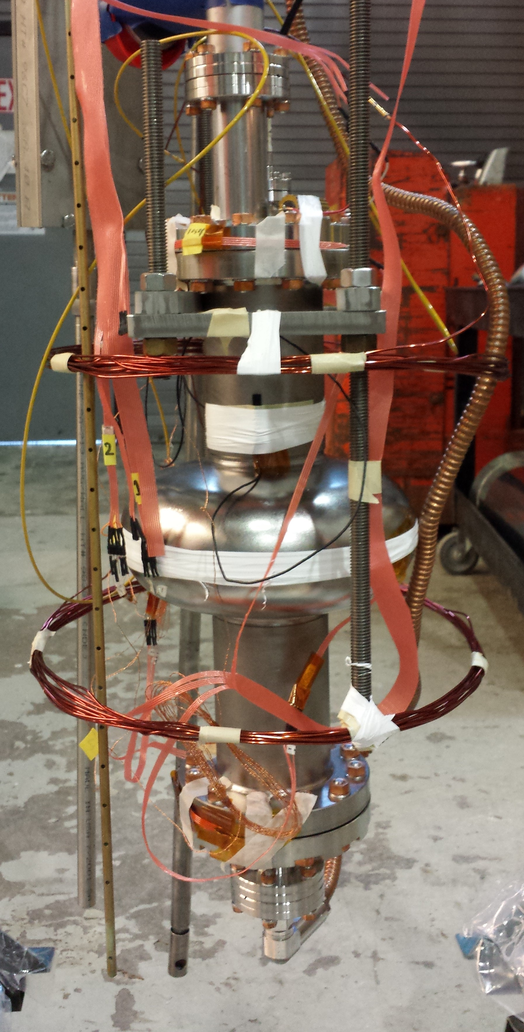
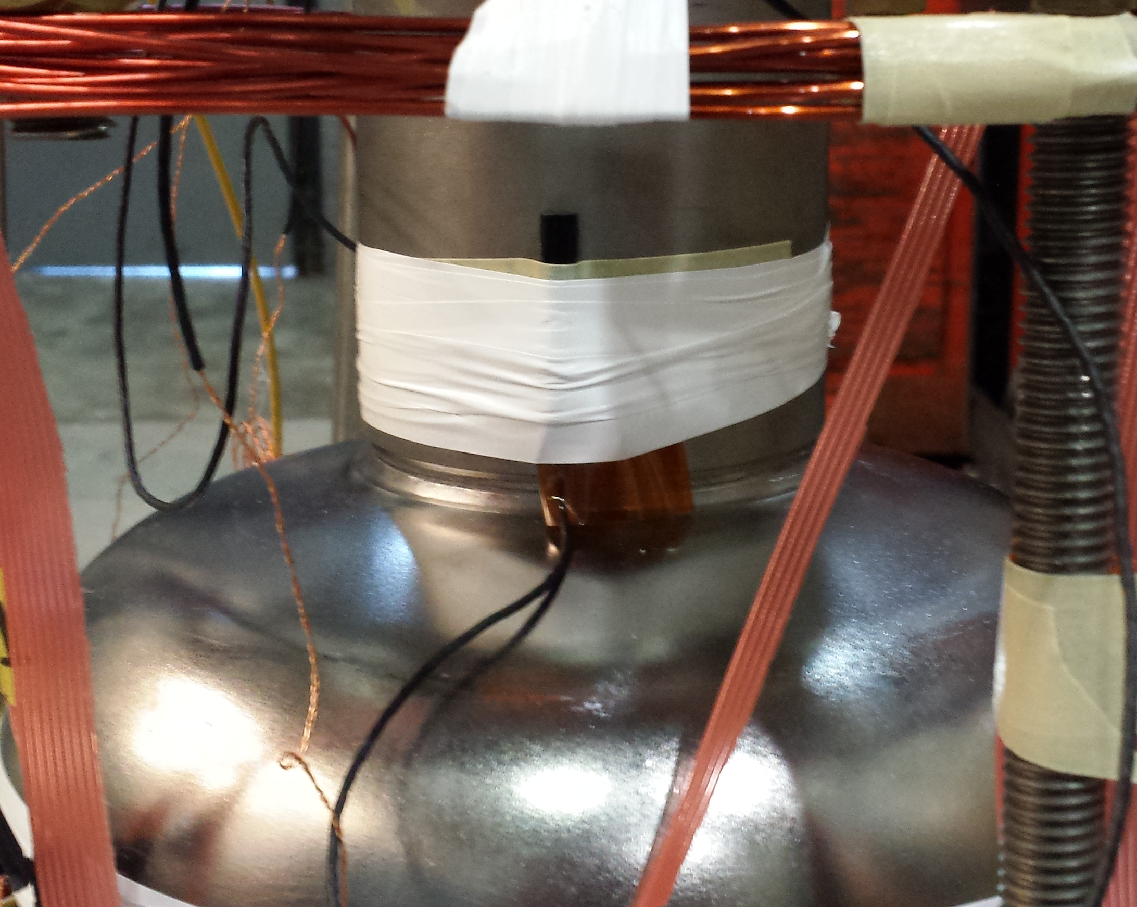
Experimental Setup
Slow Cool
Down System
Temperature Sensors
Fluxgate
Magnetometer
Helmholtz
Coil

Slide 4
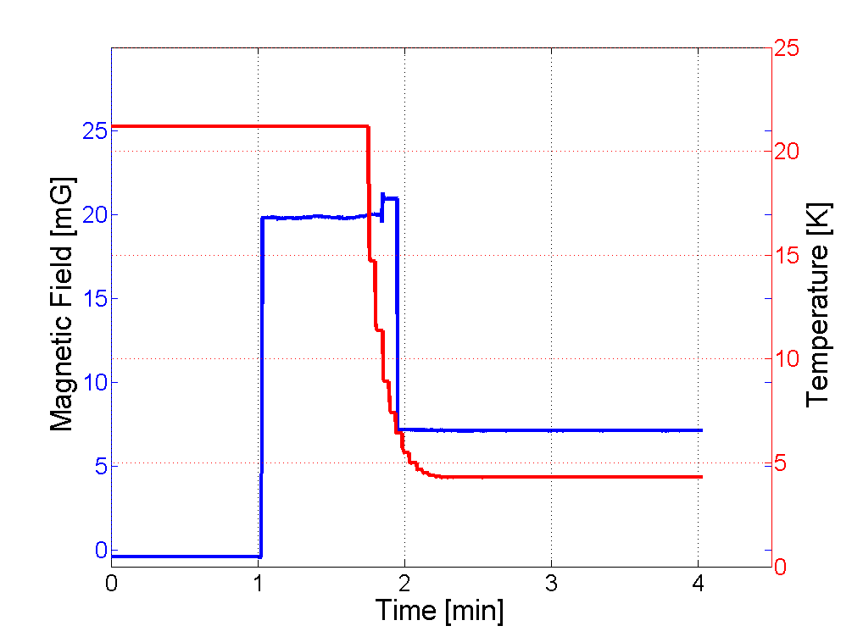
Fluxgate Measurements
T_{C}
External Field On
External Field Off,
Flux Trapped
External Field Off

Slide 5
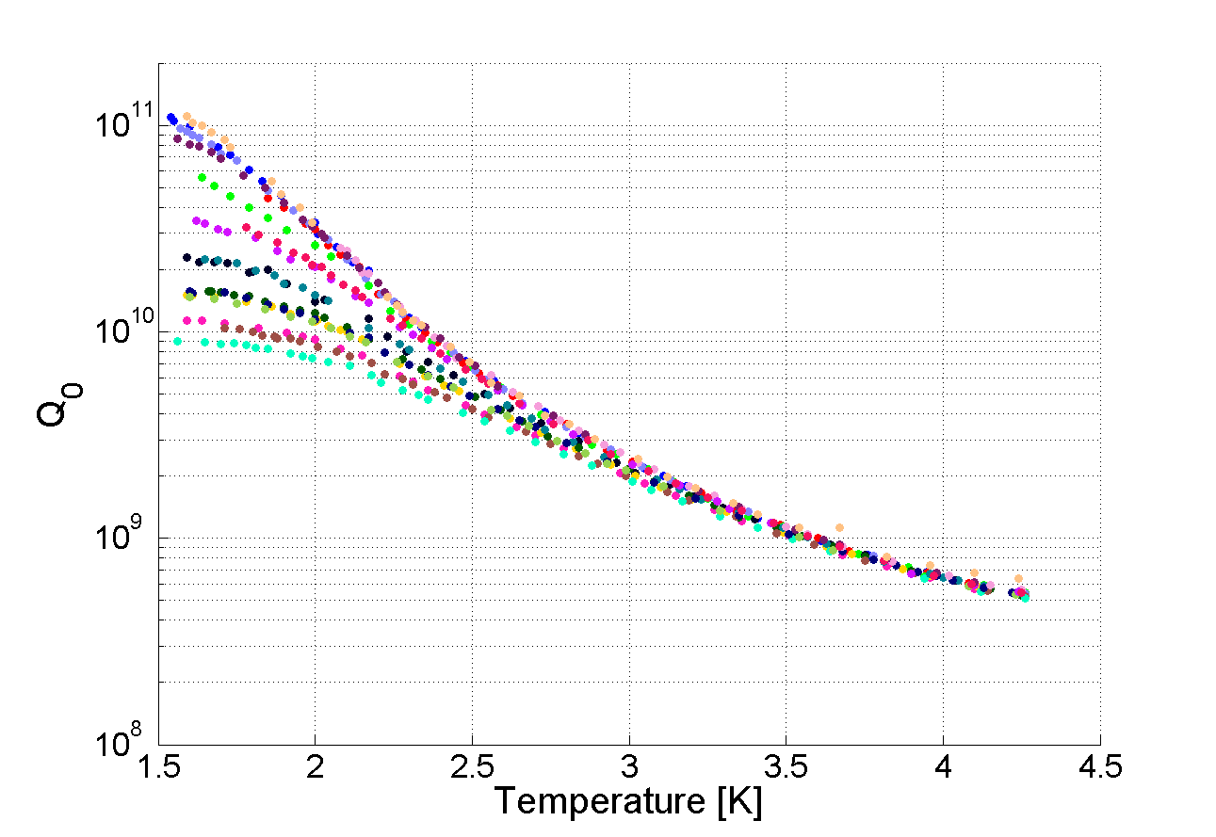
Q vs Temperature
18 cool downs with a variety of external magnetic fields and cool down rates.
Spread in Q₀ at low temperature is caused by different residual resistance depending on cool down and applied external field.

Slide 6
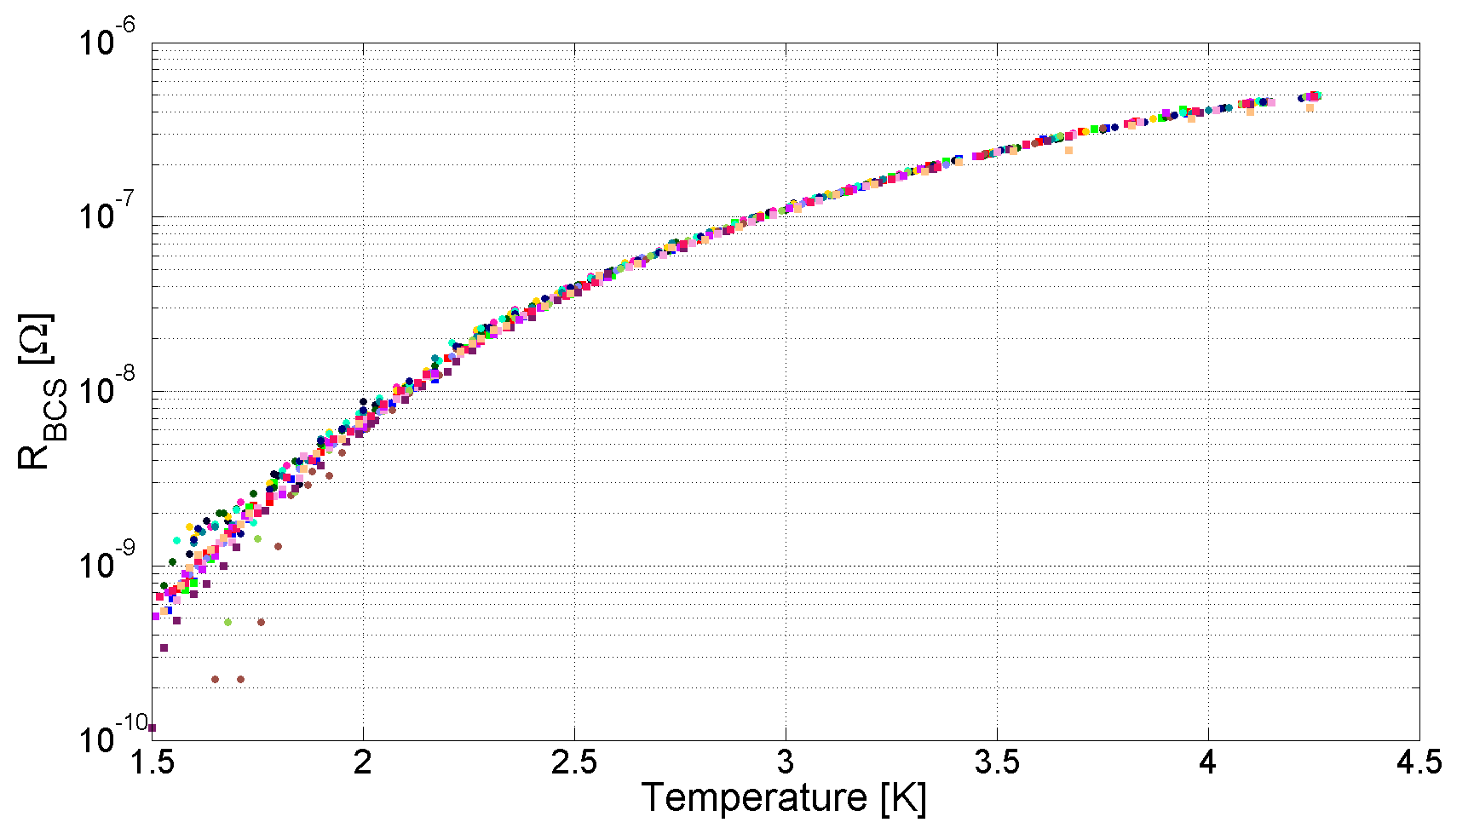
BCS Resistance vs Temperature
BCS Resistance remains unchanged regardless of cool down rate or external magnetic field – resistance from trapped flux is independent of temperature.

Slide 7
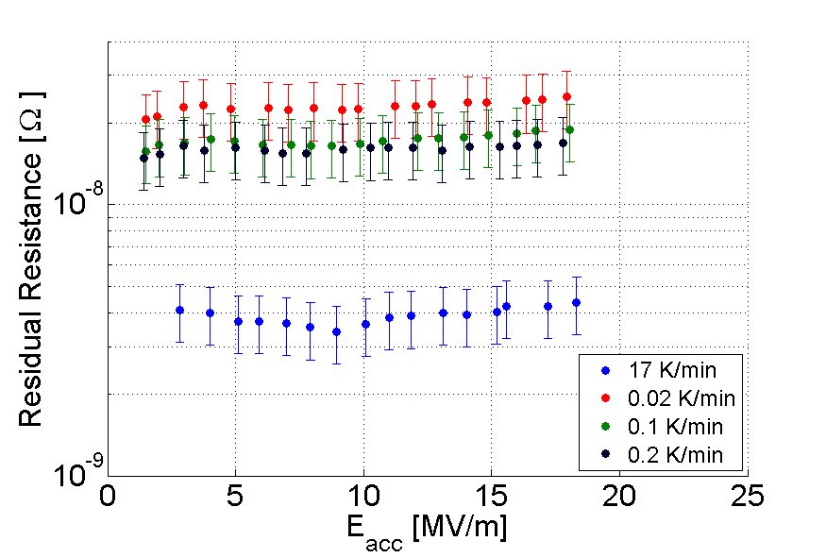
R_{res} vs Accelerating Field
Residual resistance from trapped flux is independent of accelerating field.
B_{external} = 10 mG

Slide 8
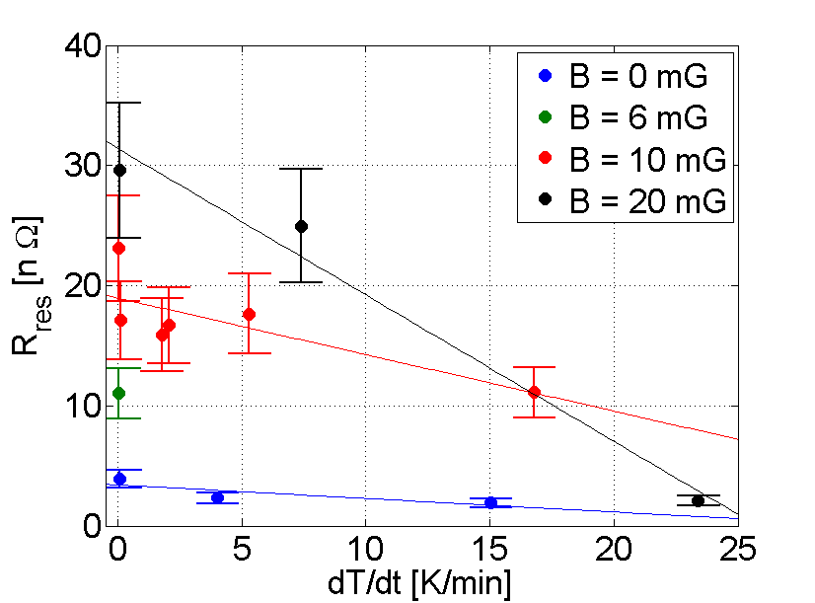
N₂ Doped: R_{res} vs Cool Down Rate
Higher applied magnetic field yields higher residual resistance.
Faster cool down rate yields less residual resistance.
For more information see my other talk in WG8: “Cavity Testing for High Q₀”

Slide 9
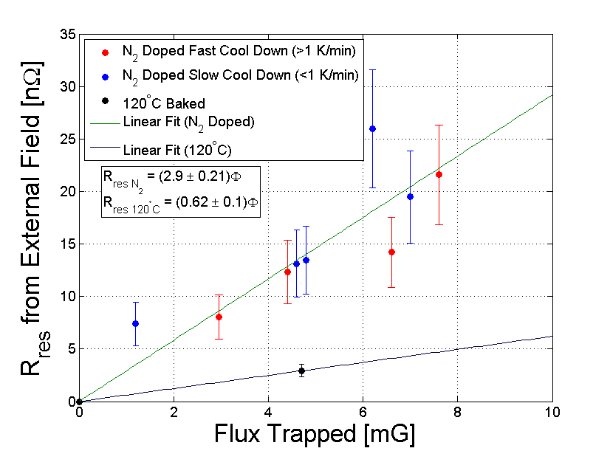
Residual Resistance from External Field vs. Trapped Flux
Amount of flux trapped depends on cool down rate and external field applied.
Initial results suggest that residual losses from trapped flux are much higher (5X) in a N₂ doped cavity than a EP+120⁰C baked cavity.

Slide 10
Conclusions
Residual resistance decreases with faster cool down in both N₂ doped and EP+120ºC baked cavities as initially found by FNAL.
Resistance from trapped flux is independent of both temperature and cavity field strength.
Residual losses from trapped flux is very different for the two cavities: the N₂ doped cavity showed 2.9±0.2 nΩ/mG trapped and the EP+120ºC cavity showed 0.6±0.1 nΩ/mG trapped.
Future work will focus on repeating this study on more cavities prepared in different ways:
Additional N₂ doped cavities, more cool downs on the EP+120ºC cavity, EP, and BCP cavities.

